Slide 1
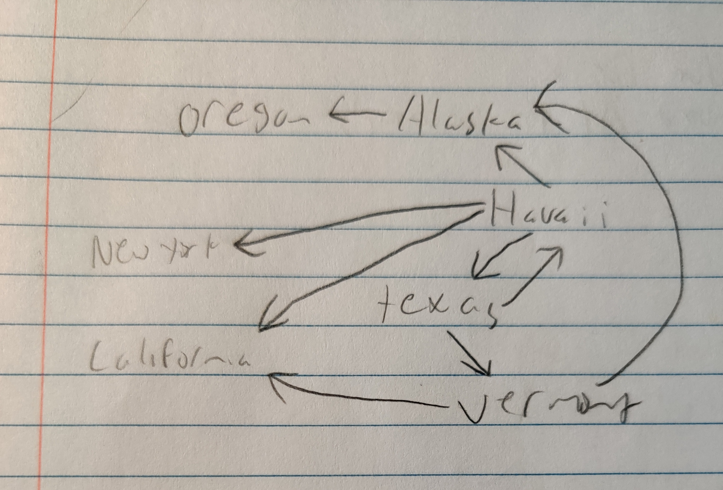
CMSC204
Kartchner
V(StateGraph) = {Oregon, Alaska, Texas, Hawaii, Vermont, NewYork, California}
E(StateGraph) = {(Alaska, Oregon), (Hawaii, Alaska), (Hawaii, Texas), (Texas, Hawaii), (Hawaii, California), (Hawaii, New York), (Texas, Vermont), (Vermont, California), (Vermont, Alaska)}
1. Draw the StateGraph
Describe the graph pictured above, using the formal graph notation.
V(StateGraph) = {Alaska, California, Hawaii, NewYork, Oregon, Texas, Vermont}
E(StateGraph) = {(Alaska, Oregon), (Hawaii, Alaska), (Hawaii, Texas), (Texas, Hawaii), (Hawaii, California), (Hawaii, New York), (Texas, Vermont), (Vermont, California), (Vermont, Alaska)}
a. Is there a path from Oregon to any other state in the graph?
No
Is there a path from Hawaii to every other state in the graph?
Yes
From which state(s) in the graph is there a path to Hawaii
Texas

Slide 2
a. Show the adjacency matrix that would describe the edges in the graph. Store the vertices in alphabetical order
 | AK | CA | HI | NY | OR | TX | VT
AK | 0 | 0 | 0 | 0 | 1 | 0 | 0
CA | 0 | 0 | 0 | 0 | 0 | 0 | 0
HI | 1 | 1 | 0 | 1 | 0 | 1 | 0
NY | 0 | 0 | 0 | 0 | 0 | 0 | 0
OR | 0 | 0 | 0 | 0 | 0 | 0 | 0
TX | 0 | 0 | 1 | 0 | 0 | 0 | 1
VT | 1 | 1 | 0 | 0 | 0 | 0 | 0
3. b. Show the adjacency lists
that would describe the edges in the graph
AK | OR
CA
HI | AK | CA | NY | TX
NY
OR
TX | HI
VT | AK | CA

Slide 3
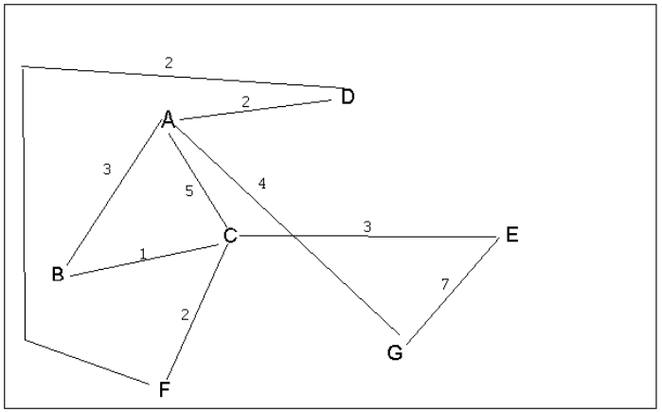
4 a. Which of the following lists the graph nodes in depth first order beginning with E?
A) E, G, F, C, D, B, A
B) G, A, E, C, B, F, D
C) E, G, A, D, F, C, B
D) E, C, F, B, A, D, G
4 b. Which of the following lists the graph nodes in breadth first order beginning at F?
A) F, C, D, A, B, E, G
B) F, D, C, A, B, C, G
C) F, C, D, B, G, A, E
D) a, b, and c are all breadth first traversals

Slide 4
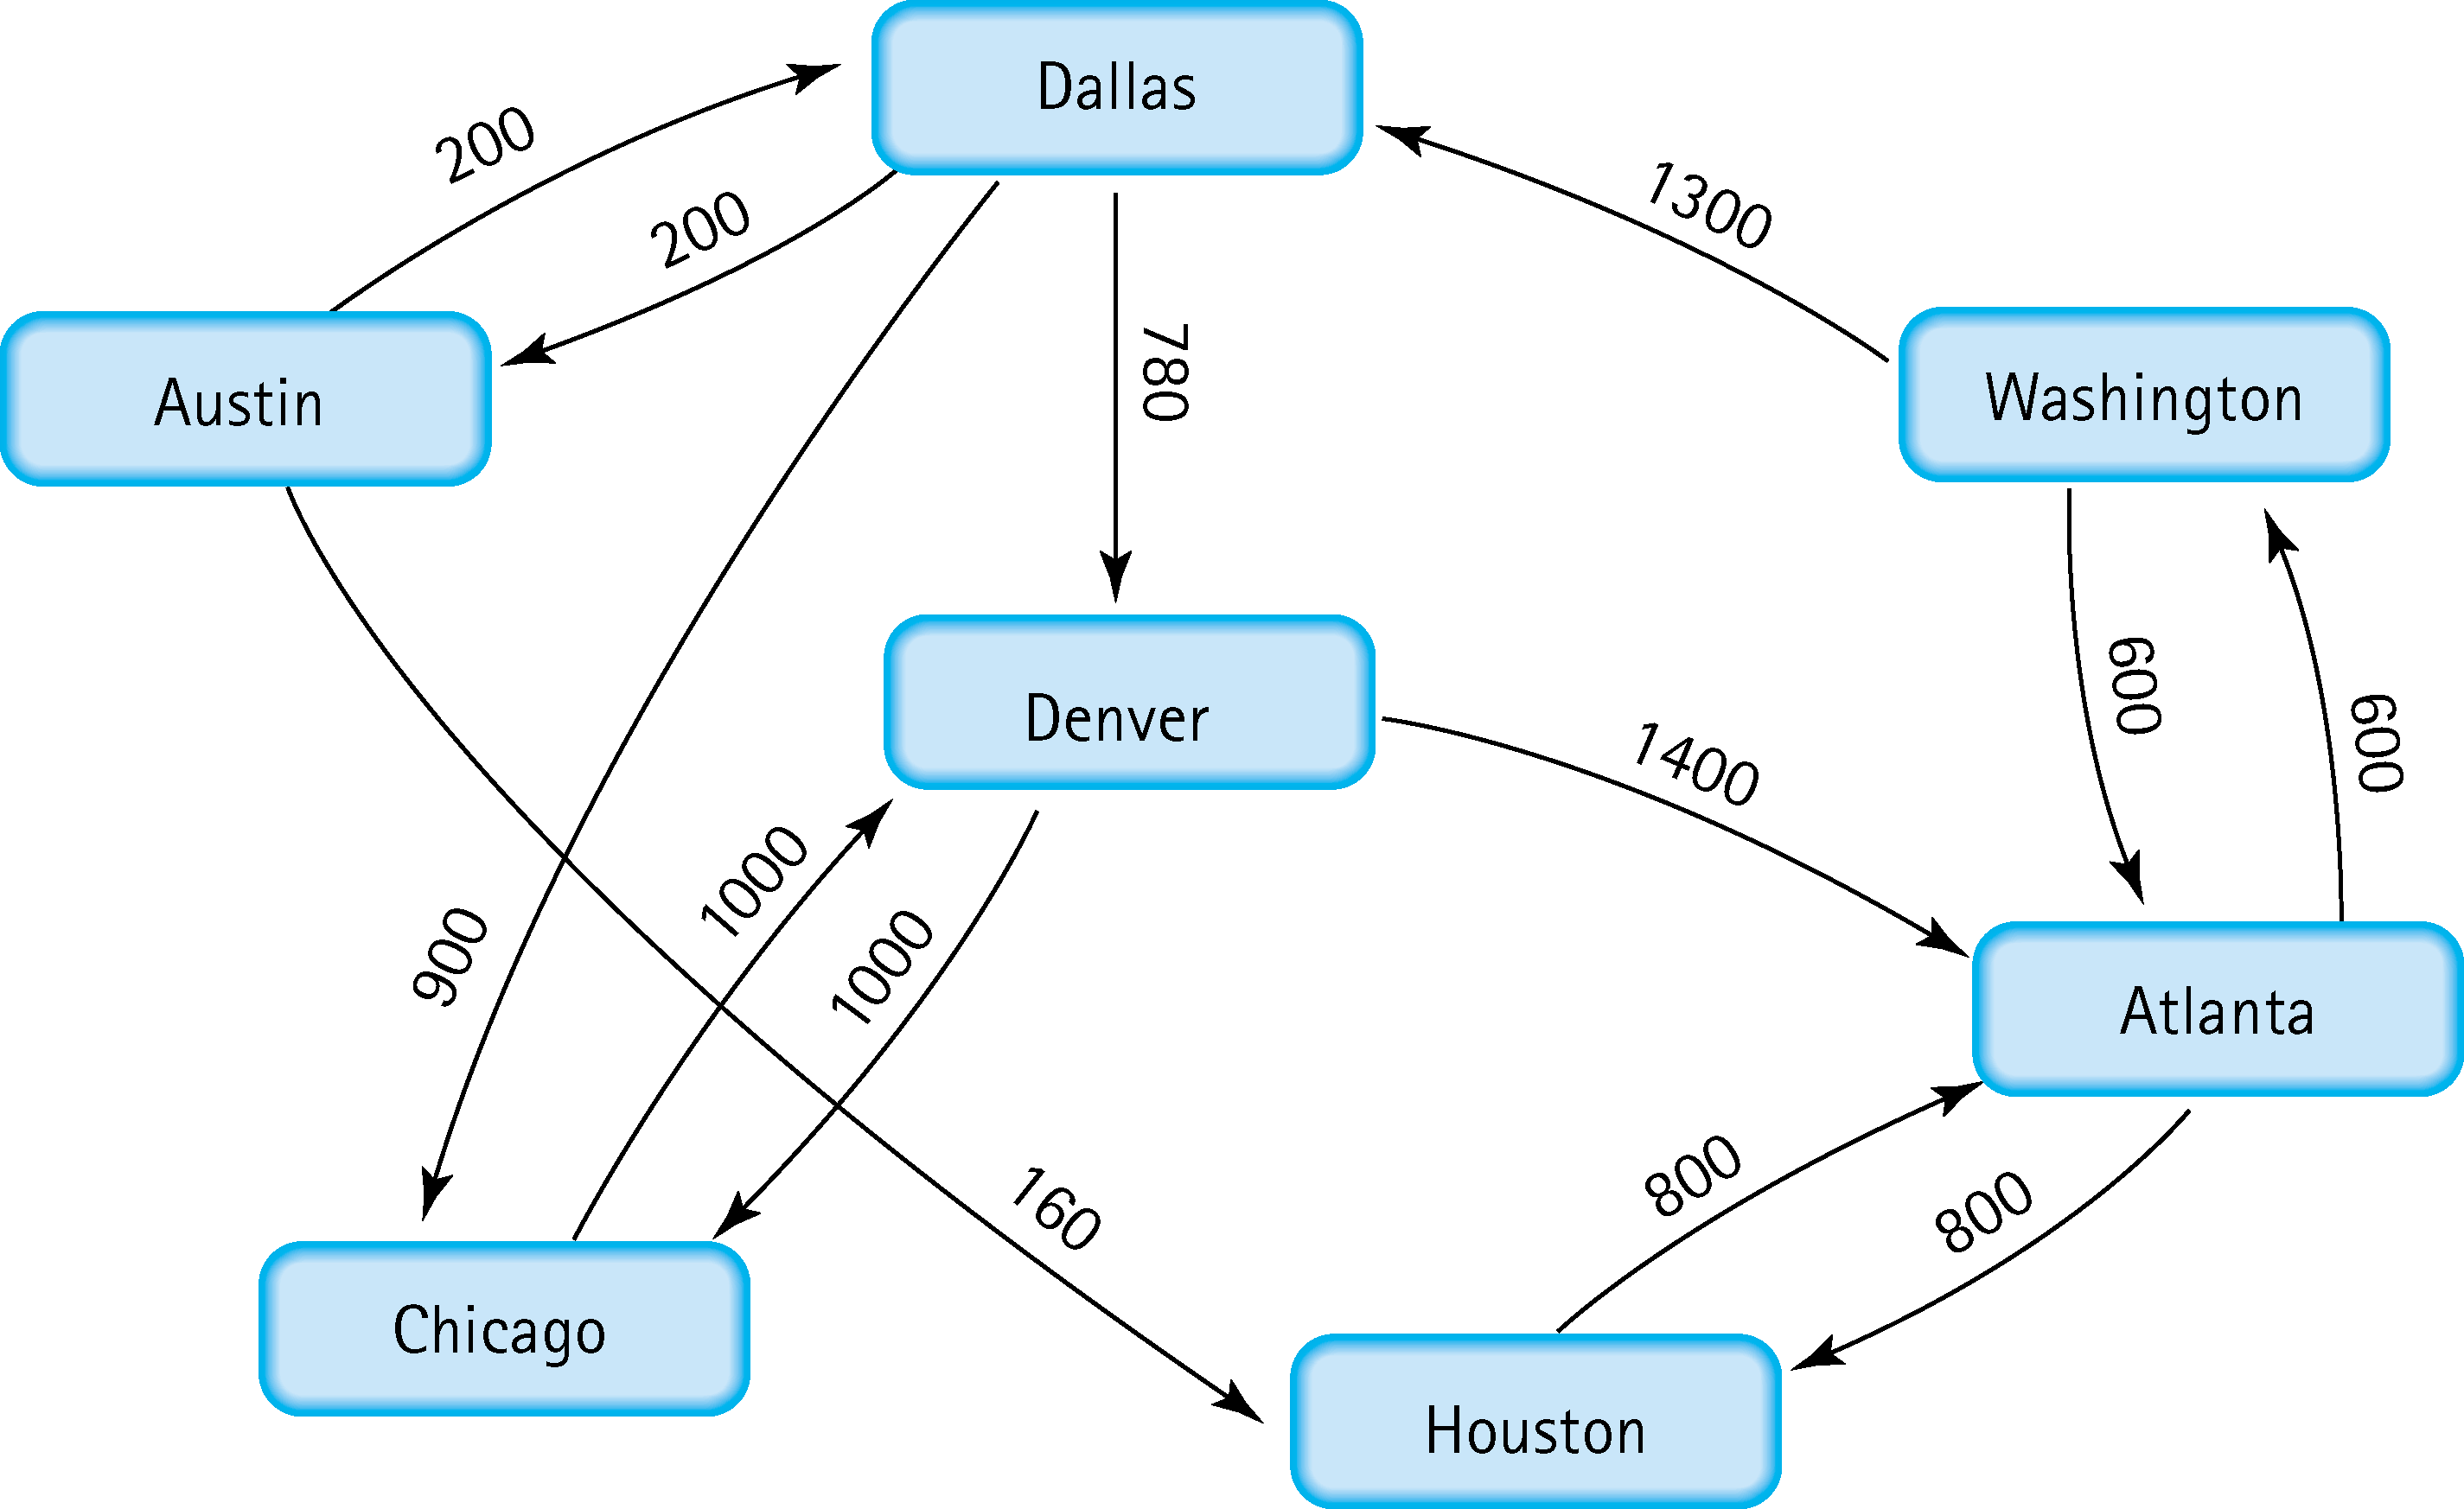
5. Find the shortest distance from Atlanta to every other city
Austin | Atlanta | +Washington | +Dallas | +Austin | =2100
Chicago | Atlanta | +Washington | +Dallas | +Chicago | =2800
Dallas | Atlanta | +Washington | +Dallas | =1900
Denver | Atlanta | +Washington | +Dallas | +Denver | =2680
Houston | Atlanta | +Houston | =800
Washington | Atlanta | +Washington | =600

Slide 5
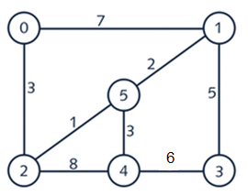
6. Find the minimal spanning tree using Prim’s algorithm. Use
0 as the source vertex . Show the steps.

Slide 6
7. Find the minimal spanning tree using Kruskal’s algorithm.
Show the weights in order and the steps.
Weight | Input | Output
1 | 2 | 5
2 | 5 | 1
3 | 0 | 2
3 | 5 | 4
5 | 1 | 3
6 | 4 | 3
7 | 0 | 1
8 | 2 | 4

Slide 7
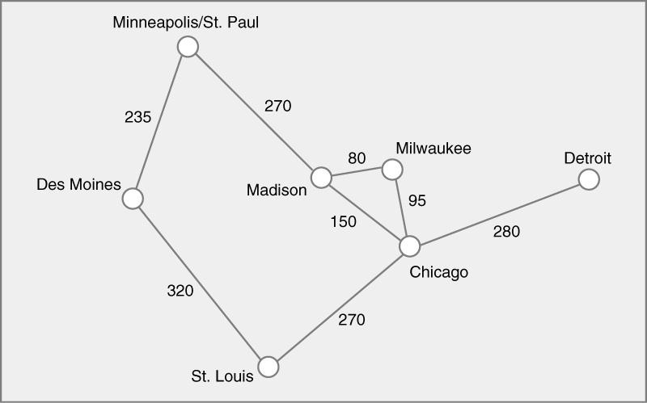
8. Find the minimal spanning tree using the algorithm you prefer. Use
Minneapolis/St. Paul as the source vertex
Weight | Input | Output
80 | Milwaukee | Madison
95 | Milwaukee | Chicago
150 | Chicago | Madison
235 | St.Paul | Des Moines
270 | St.Paul | Madison
270 | Chicago | St.Louis
280 | Chicago | Detroit
320 | Des Moines | St.Louis

Slide 8
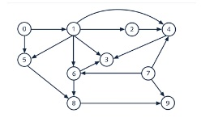
9. List the nodes of the graph in a breadth first topological ordering. Show the
steps using arrays predCount, topologicalOrder and a queue
predCount
1 | 0 | 0 | 0 | 0 | 0 | 0 | 0 | 0 | 0
1 | 0 | 0 | 0 | 0 | 0 | 0 | 1 | 0 | 0
1 | 1 | 0 | 0 | 1 | 1 | 1 | 1 | 0 | 1
1 | 1 | 1 | 3 | 2 | 1 | 1 | 1 | 2 | 1
topologicalOrder
0 | 0 | 0 | 0 | 0 | 0 | 0 | 0 | 0 | 0
0 | 7 | 0 | 0 | 0 | 0 | 0 | 1 | 0 | 0
0 | 7 | 1 | 5 | 4 | 6 | 9 | 0 | 0 | 0
0 | 7 | 1 | 5 | 4 | 6 | 9 | 2 | 3 | 8
Queue: 0 7 1 5 4 6 9 2 3 8

Slide 9

10. List the nodes of the graph in a breadth first topological ordering.
Discrete Math, Programming 1, Programming 2, Computer Organization, Algorithms, High level languages, Operating systems, Theory of Computation, Senior Seminar, Compilers

